Slide 1
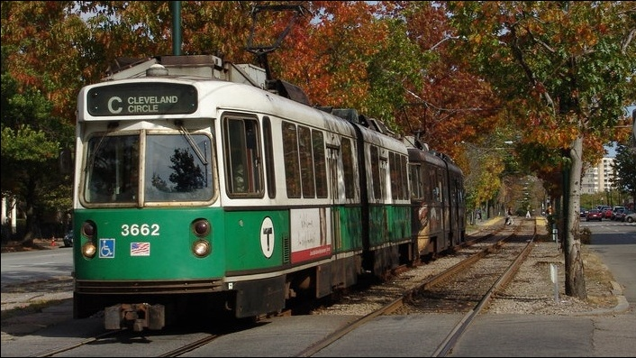
Boston TRAIN OPERATIONS MANAGEMENT SYSTEM
TEAM MAVERICKS
Presented by:
Additya Dharangaonkar : NUID – 001052304
Samarth Hadawale : NUID – 001053811
Rohan Kapadnis : NUID – 001342161
Priyanka Pal : NUID – 001059632
Parthiv Shah : NUID – 001059325

Slide 2

OBJECTIVES
Developing a centralized Train Management Database System for the City of Boston, which will facilitate functionalities like Searching Schedule, Booking and Cancellation of tickets with the aim of improving upon the current system by saving passenger’s time & efforts in the process.

Slide 3
Summary of the design
This system has eleven entities interconnected with each other. Most important ones being TrainSchedule, Passenger, TicketBooking. TrainSchedule which is the central entity interacts with several other entities to search the Train Schedule between Source and Destination on the basis of time preference.
The Passenger entity uses the above search result for TicketBooking. It also has an additional facility to cancel the ticket.
The Administrator can handle the entire operation by analysing the overall real-time scenario of the train system.
This system has been designed by keeping in mind the User's as well as Administrator's perspective.

Slide 4
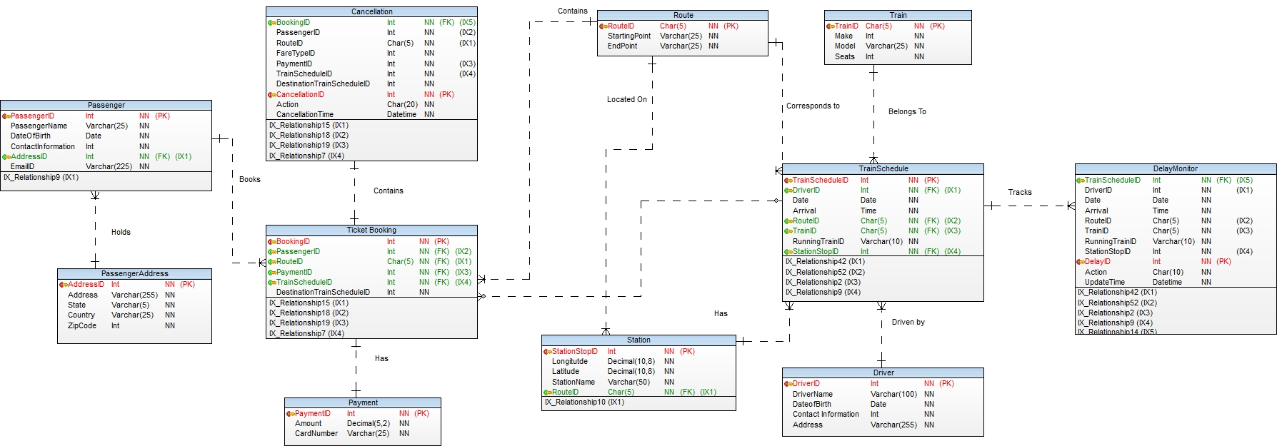
Entity RELATIONSHIP DIAGRAM

Slide 5
DDL & DML(Passenger)
CREATE TABLE [dbo].[Passenger]( [PassengerID] [int] NOT NULL, [PassengerName] [varchar](25) NOT NULL, [DateofBirth] [date] NOT NULL, [ContactInformation] [int] NOT NULL, [AddressID] [int] NOT NULL, [EmailID] [varchar](225) NOT NULL, [CurrentAge] AS (datediff(year,[DateofBirth],getdate())), CONSTRAINT [Passenger_PK] PRIMARY KEY CLUSTERED ( [PassengerID] ASC )WITH (PAD_INDEX = OFF, STATISTICS_NORECOMPUTE = OFF, IGNORE_DUP_KEY = OFF, ALLOW_ROW_LOCKS = ON, ALLOW_PAGE_LOCKS = ON) ON [PRIMARY] ) ON [PRIMARY]
INSERT INTO Passenger values(1,'Priyanka','10-12-1996',485962586,1,'priyanka@gmail.com') INSERT INTO Passenger values(2,'Parthiv Shah','05-11-1997',125896354,2,'parthiv.shah@gmail.com')

Slide 6
DDL & DML(Passenger ADDRESS)
CREATE TABLE [dbo].[PassengerAddress]( [AddressID] [int] NOT NULL, [Address] [varchar](255) NOT NULL, [State] [varchar](5) NOT NULL, [Country] [varchar](25) NOT NULL, [ZipCode] [int] NOT NULL, CONSTRAINT [PassengerAddress_PK] PRIMARY KEY CLUSTERED ( [AddressID] ASC )WITH (PAD_INDEX = OFF, STATISTICS_NORECOMPUTE = OFF, IGNORE_DUP_KEY = OFF, ALLOW_ROW_LOCKS = ON, ALLOW_PAGE_LOCKS = ON) ON [PRIMARY] ) ON [PRIMARY]
insert into PassengerAddress values (1,'1175 boly','MA','USA',421563) insert into PassengerAddress values (2,'1572 Tremont St','MA','USA',02110)

Slide 7
DDL & DML(DRIVER)
CREATE TABLE [dbo].[Driver]( [DriverID] [int] NOT NULL, [DriverName] [varchar](100) NOT NULL, [DateofBirth] [date] NOT NULL, [Contact Information] [int] NOT NULL, [Address] [varchar](255) NOT NULL, CONSTRAINT [Driver_PK] PRIMARY KEY CLUSTERED ( [DriverID] ASC )WITH (PAD_INDEX = OFF, STATISTICS_NORECOMPUTE = OFF, IGNORE_DUP_KEY = OFF, ALLOW_ROW_LOCKS = ON, ALLOW_PAGE_LOCKS = ON) ON [PRIMARY] ) ON [PRIMARY]
INSERT INTO Driver Values(1,'Jamie Vardy','06-11-1980',25612589,'45 Tremont St') INSERT INTO Driver VALUES(2,'James Maddison','09-01-1990',7891030,'101 Hemenway')

Slide 8
DDL & DML(ROUTE)
CREATE TABLE [dbo].[Route]( [RouteID] [char](5) NOT NULL, [StartPoint] [varchar](25) NOT NULL, [EndPoint] [varchar](25) NOT NULL, CONSTRAINT [Route_PK] PRIMARY KEY CLUSTERED ( [RouteID] ASC )WITH (PAD_INDEX = OFF, STATISTICS_NORECOMPUTE = OFF, IGNORE_DUP_KEY = OFF, ALLOW_ROW_LOCKS = ON, ALLOW_PAGE_LOCKS = ON) ON [PRIMARY] ) ON [PRIMARY]
INSERT INTO Route(RouteID,StartPoint,EndPoint) VALUES ('GB1','Boston College','Lechmere'); INSERT INTO Route(RouteID,StartPoint,EndPoint) VALUES ('GB2','Lechmere','Boston College');
INSERT INTO Route(RouteID,StartPoint,EndPoint) VALUES ('O1','Oak Grove','Forest Hills');

Slide 9
DDL & DML(STATION)
CREATE TABLE [dbo].[Station]( [StationStopID] [int] NOT NULL, [Longitude] [decimal](10, 8) NOT NULL, [Latitude] [decimal](10, 8) NOT NULL, [RouteID] [char](5) NOT NULL, [StationName] [varchar](50) NOT NULL, CONSTRAINT [Station_PK] PRIMARY KEY CLUSTERED ( [StationStopID] ASC )WITH (PAD_INDEX = OFF, STATISTICS_NORECOMPUTE = OFF, IGNORE_DUP_KEY = OFF, ALLOW_ROW_LOCKS = ON, ALLOW_PAGE_LOCKS = ON) ON [PRIMARY] ) ON [PRIMARY] GOALTER TABLE [dbo].[Station] WITH CHECK ADD CONSTRAINT [Station_FK] FOREIGN KEY([RouteID]) REFERENCES [dbo].[Route] ([RouteID]) GOALTER TABLE [dbo].[Station] CHECK CONSTRAINT [Station_FK]
INSERT INTO Station(StationStopID,Longitude,Latitude,RouteID,StationName) VALUES (83,-71.08880679,42.34040135,'GE1','Northeastern University')
INSERT INTO Station(StationStopID,Longitude,Latitude,RouteID,StationName) VALUES (328,-71.09248662,42.26762068,'RM1','Mattapan');
INSERT INTO Station(StationStopID,Longitude,Latitude,RouteID,StationName) VALUES (1,-71.16708193,42.34012587,'GB1','Boston College');

Slide 10
DDL & DML(payment)
CREATE TABLE [dbo].[Payment]( [PaymentID] [int] NOT NULL, [Amount] [decimal](5, 2) NOT NULL, [CardNumber] [varchar](25) NULL, [Credit_card_number_encrypt] [varbinary](max) NULL, CONSTRAINT [Payment_PK] PRIMARY KEY CLUSTERED ( [PaymentID] ASC )WITH (PAD_INDEX = OFF, STATISTICS_NORECOMPUTE = OFF, IGNORE_DUP_KEY = OFF, ALLOW_ROW_LOCKS = ON, ALLOW_PAGE_LOCKS = ON) ON [PRIMARY], UNIQUE NONCLUSTERED ( [PaymentID] ASC )WITH (PAD_INDEX = OFF, STATISTICS_NORECOMPUTE = OFF, IGNORE_DUP_KEY = OFF, ALLOW_ROW_LOCKS = ON, ALLOW_PAGE_LOCKS = ON) ON [PRIMARY] ) ON [PRIMARY] TEXTIMAGE_ON [PRIMARY] GOALTER TABLE [dbo].[Payment] WITH CHECK ADD CHECK (([Amount]=(2.50)))
INSERT INTO Payment(PaymentID,Amount,CardNumber) VALUES (1007,2.5,5211948461024870); INSERT INTO Payment(PaymentID,Amount,CardNumber) VALUES (1008,2.5,5261227817678810); INSERT INTO Payment(PaymentID,Amount,CardNumber) VALUES (1009,2.5,5376654550614300);

Slide 11
DDL & DML(train)
CREATE TABLE [dbo].[Train]( [TrainID] [char](5) NOT NULL, [Make] [int] NOT NULL, [Model] [varchar](25) NOT NULL, [Seats] [int] NOT NULL, CONSTRAINT [Train_PK] PRIMARY KEY CLUSTERED ( [TrainID] ASC )WITH (PAD_INDEX = OFF, STATISTICS_NORECOMPUTE = OFF, IGNORE_DUP_KEY = OFF, ALLOW_ROW_LOCKS = ON, ALLOW_PAGE_LOCKS = ON) ON [PRIMARY] ) ON [PRIMARY]
INSERT INTO Train values ('TB1', 2007, 'AX2', 100), ('TB2', 2006, 'AS4', 100), ('TB3', 2011, 'VG4', 100), ('TB4', 2010, 'UY7', 100)

Slide 12
DDL & DML(train SCHEDULE)
CREATE TABLE [dbo].[TrainSchedule]( [TrainScheduleID] [int] NOT NULL, [RunningTrainID] [varchar](10) NOT NULL, [TrainID] [char](5) NOT NULL, [StationStopID] [int] NOT NULL, [Arrival] [time](0) NOT NULL, [Date] [date] NOT NULL, [RouteID] [char](5) NOT NULL, [DriverID] [int] NOT NULL, CONSTRAINT [TrainSchedule_PK] PRIMARY KEY CLUSTERED ( [TrainScheduleID] ASC )WITH (PAD_INDEX = OFF, STATISTICS_NORECOMPUTE = OFF, IGNORE_DUP_KEY = OFF, ALLOW_ROW_LOCKS = ON, ALLOW_PAGE_LOCKS = ON) ON [PRIMARY] ) ON [PRIMARY] GOALTER TABLE [dbo].[TrainSchedule] WITH CHECK ADD CONSTRAINT [TrainSchedule_FK1] FOREIGN KEY([StationStopID]) REFERENCES [dbo].[Station] ([StationStopID]) GOALTER TABLE [dbo].[TrainSchedule] CHECK CONSTRAINT [TrainSchedule_FK1] GOALTER TABLE [dbo].[TrainSchedule] WITH CHECK ADD CONSTRAINT [TrainSchedule_FK2] FOREIGN KEY([RouteID]) REFERENCES [dbo].[Route] ([RouteID]) GOALTER TABLE [dbo].[TrainSchedule] CHECK CONSTRAINT [TrainSchedule_FK2] GOALTER TABLE [dbo].[TrainSchedule] WITH CHECK ADD CONSTRAINT [TrainSchedule_FK3] FOREIGN KEY([DriverID]) REFERENCES [dbo].[Driver] ([DriverID]) GOALTER TABLE [dbo].[TrainSchedule] CHECK CONSTRAINT [TrainSchedule_FK3]
INSERT INTO TrainSchedule(TrainScheduleID,RunningTrainID,TrainID,StationStopID,Arrival,Date,RouteID,DriverID) VALUES (1,'RB1','TB1',114,'6:00:00','2019-12-09','B1',1); INSERT INTO TrainSchedule(TrainScheduleID,RunningTrainID,TrainID,StationStopID,Arrival,Date,RouteID,DriverID) VALUES (2,'RB1','TB1',115,'6:11:00','2019-12-09','B1',1)
INSERT INTO TrainSchedule(TrainScheduleID,RunningTrainID,TrainID,StationStopID,Arrival,Date,RouteID,DriverID) VALUES (589,'RGB7','TGB2',13,'15:09:00','2019-12-09','GB1',6); INSERT INTO TrainSchedule(TrainScheduleID,RunningTrainID,TrainID,StationStopID,Arrival,Date,RouteID,DriverID) VALUES (590,'RGB7','TGB2',14,'15:18:00','2019-12-09','GB1',6);

Slide 13
DDL & DML(tICKET BOOKING)
CREATE TABLE [dbo].[TicketBooking]( [BookingID] [int] NOT NULL, [PassengerID] [int] NOT NULL, [RouteID] [char](5) NOT NULL, [PaymentID] [int] NOT NULL, [SourceTrainScheduleID] [int] NULL, [DestinationTrainScheduleID] [int] NULL, CONSTRAINT [TicketBooking_PK] PRIMARY KEY CLUSTERED ( [BookingID] ASC )WITH (PAD_INDEX = OFF, STATISTICS_NORECOMPUTE = OFF, IGNORE_DUP_KEY = OFF, ALLOW_ROW_LOCKS = ON, ALLOW_PAGE_LOCKS = ON) ON [PRIMARY], UNIQUE NONCLUSTERED ( [BookingID] ASC )WITH (PAD_INDEX = OFF, STATISTICS_NORECOMPUTE = OFF, IGNORE_DUP_KEY = OFF, ALLOW_ROW_LOCKS = ON, ALLOW_PAGE_LOCKS = ON) ON [PRIMARY] ) ON [PRIMARY] GOALTER TABLE [dbo].[TicketBooking] WITH CHECK ADD CONSTRAINT [TicketBooking_FK1] FOREIGN KEY([RouteID]) REFERENCES [dbo].[Route] ([RouteID]) GOALTER TABLE [dbo].[TicketBooking] CHECK CONSTRAINT [TicketBooking_FK1] GOALTER TABLE [dbo].[TicketBooking] WITH CHECK ADD CONSTRAINT [TicketBooking_FK2] FOREIGN KEY([SourceTrainScheduleID]) REFERENCES [dbo].[TrainSchedule] ([TrainScheduleID]) GOALTER TABLE [dbo].[TicketBooking] CHECK CONSTRAINT [TicketBooking_FK2] GOALTER TABLE [dbo].[TicketBooking] WITH CHECK ADD CONSTRAINT [TicketBooking_FK3] FOREIGN KEY([DestinationTrainScheduleID]) REFERENCES [dbo].[TrainSchedule] ([TrainScheduleID]) GOALTER TABLE [dbo].[TicketBooking] CHECK CONSTRAINT [TicketBooking_FK3] GOALTER TABLE [dbo].[TicketBooking] WITH CHECK ADD CONSTRAINT [TicketBooking_FK4] FOREIGN KEY([PaymentID]) REFERENCES [dbo].[Payment] ([PaymentID]) GOALTER TABLE [dbo].[TicketBooking] CHECK CONSTRAINT [TicketBooking_FK4]
INSERT INTO TicketBooking(BookingID,PassengerID,RouteID,PaymentID,SourceTrainScheduleID,DestinationTrainScheduleID) VALUES (1,1,'B1',1001,1,8);
INSERT INTO TicketBooking(BookingID,PassengerID,RouteID,PaymentID,SourceTrainScheduleID,DestinationTrainScheduleID) VALUES (88,88,'GE1',1088,2217,2224);
INSERT INTO TicketBooking(BookingID,PassengerID,RouteID,PaymentID,SourceTrainScheduleID,DestinationTrainScheduleID) VALUES (177,177,'RM2',1177,3705,3708);

Slide 14
Stored PROCEDURES
TrainScheduleOutbound
TrainScheduleInbound
AddPassengerDetails
ReachingTimeForDesiredDestination
DriverSchedule

Slide 15
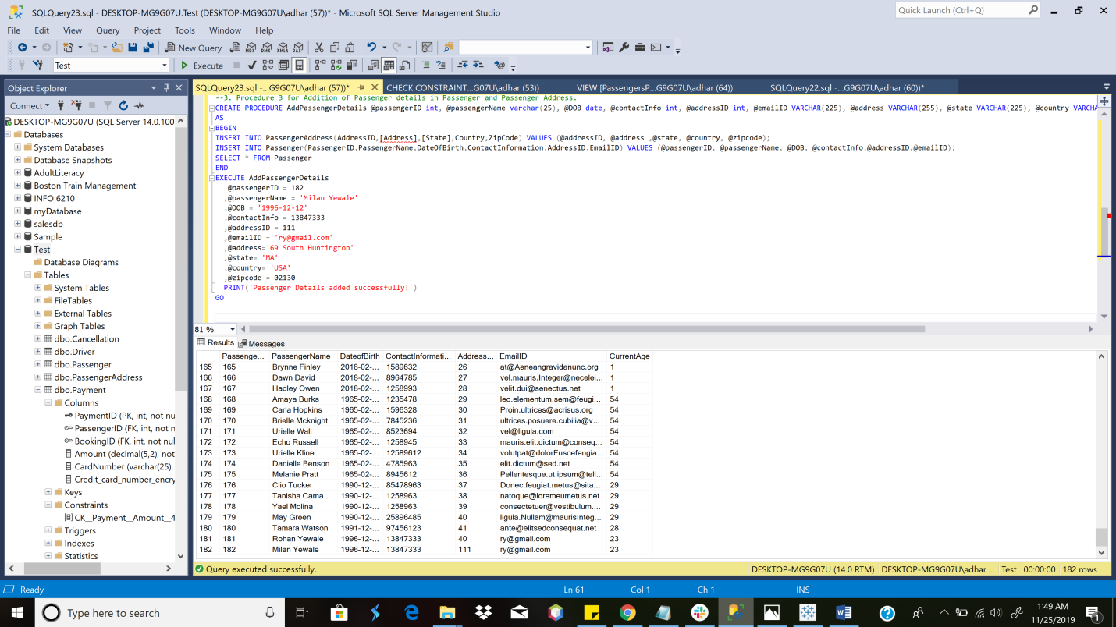
Stored Procedure (to add Passenger Details)

Slide 16
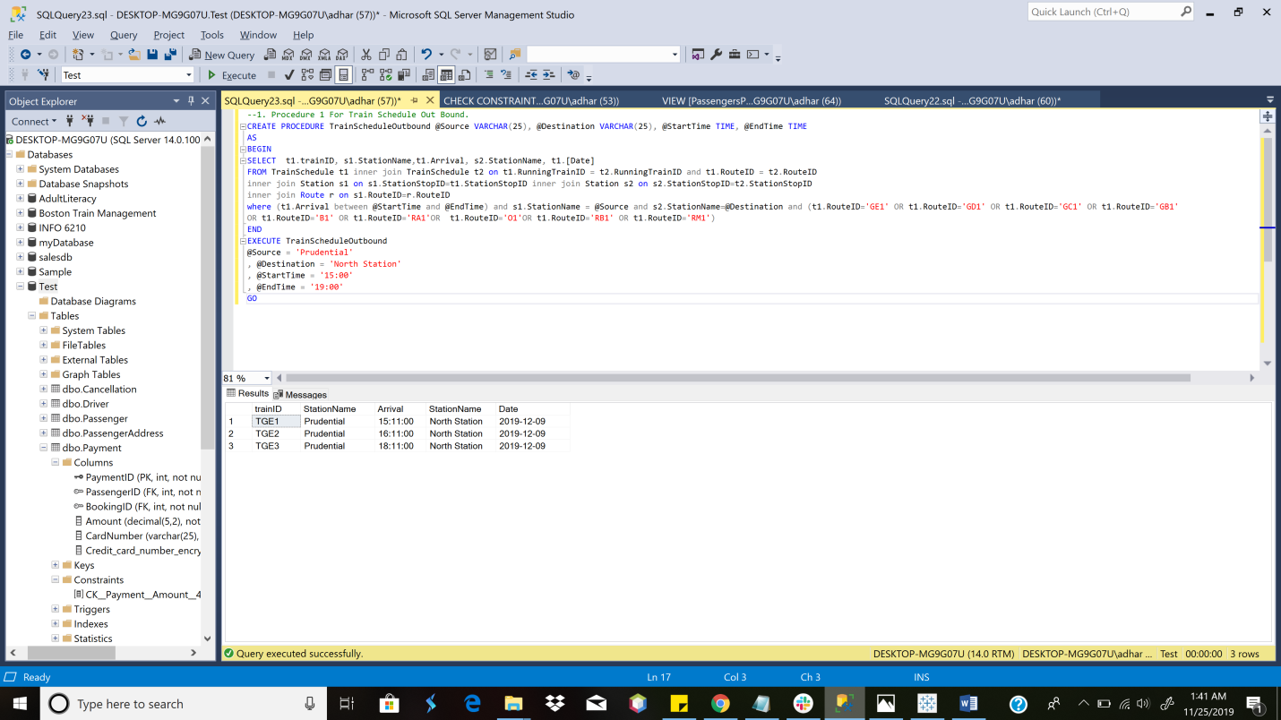
STORED PROCEDURE (For Train Schedule Out Bound)

Slide 17
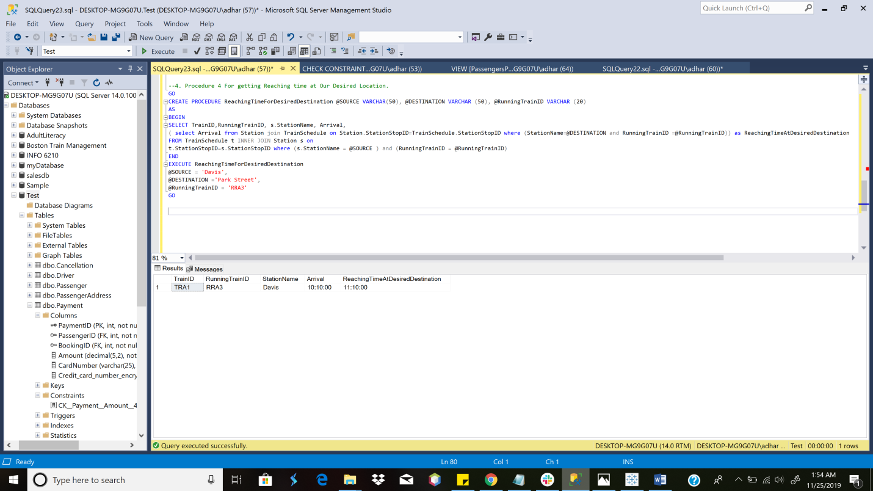
Stored Procedure (to get Reaching Time at Desired Location)

Slide 18
TRIGGERS
DelayMonitor
TicketCancellation

Slide 19
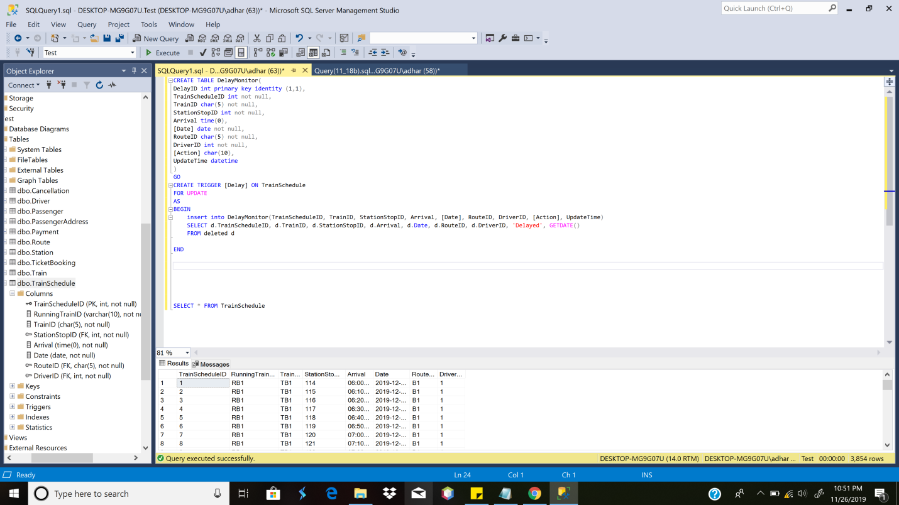
TRIGGERS(Delay monitor 1)

Slide 20
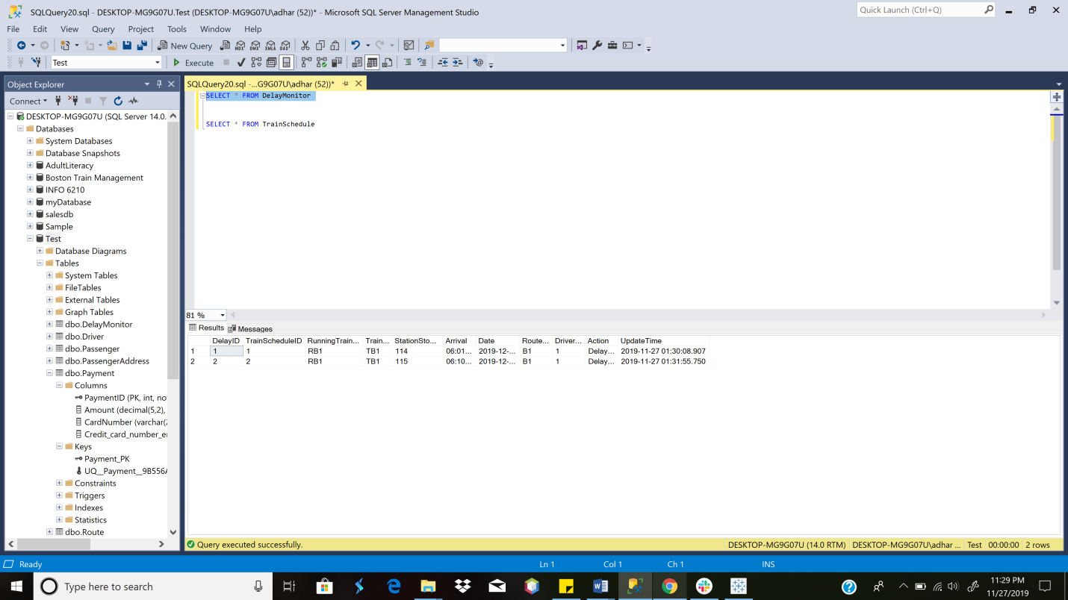
TRIGGER(DELAY MONITOR 2)

Slide 21
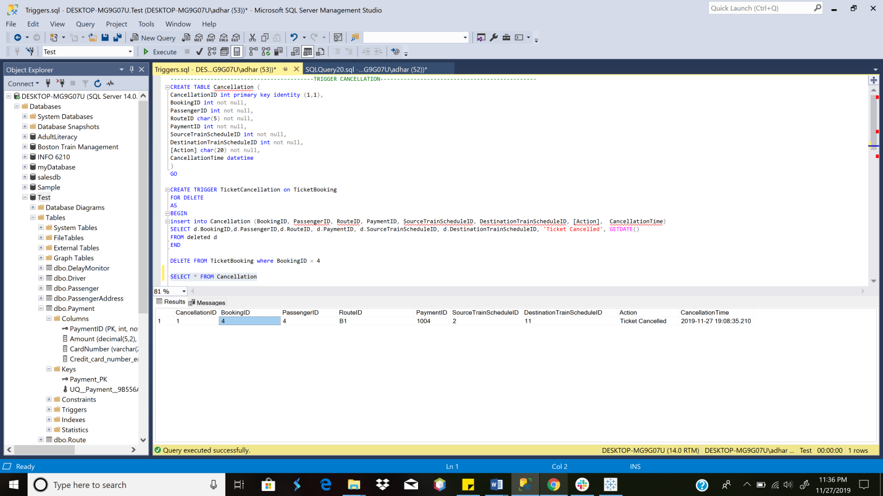
TRIGGER(BOOKING CANCELLATION 1)

Slide 22
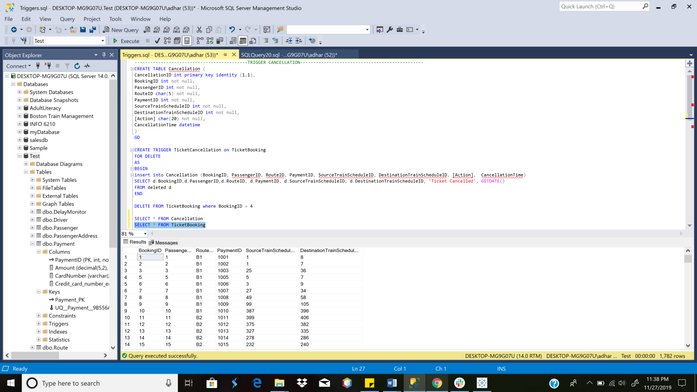
TRIGGER(BOOKING CANCELLATION 2)

Slide 23
VIEWS
PassengerPerRunningTrain
RevenueByRoute
Onboarders
Deboarders

Slide 24
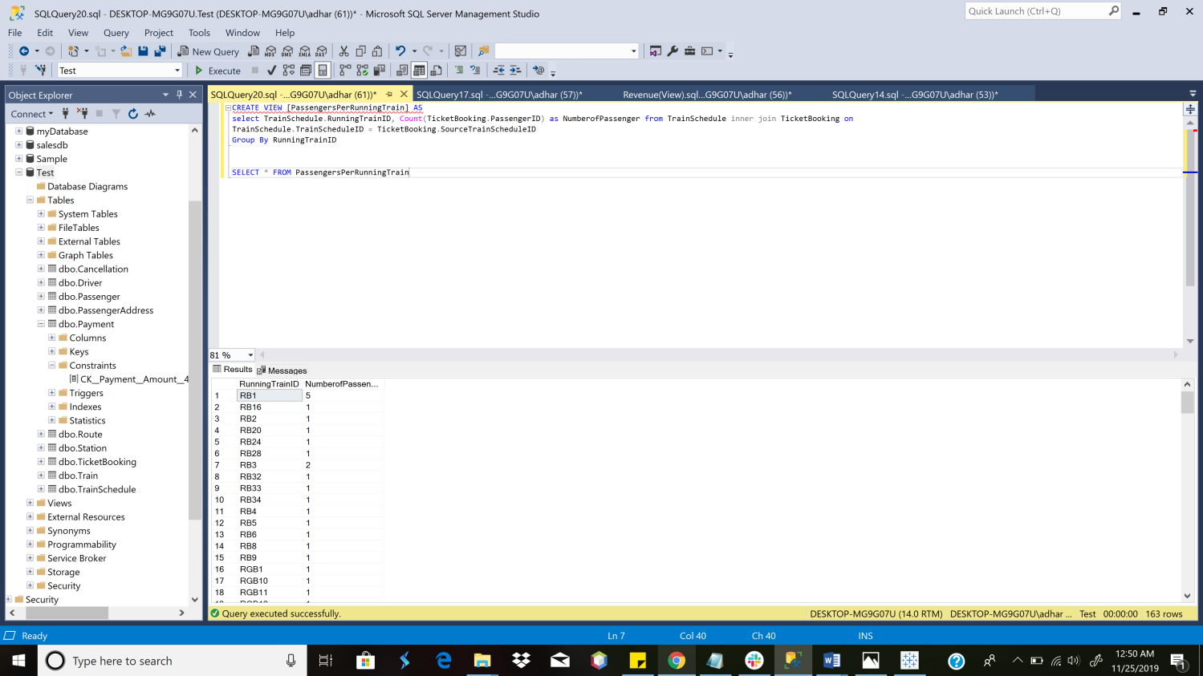
VIEW (PassengerS Per Running Train)

Slide 25
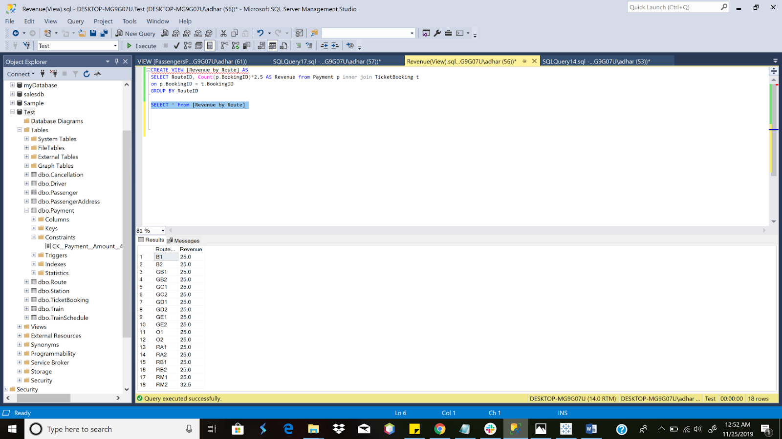
VIEW (REVENUE BY ROUTE)

Slide 26
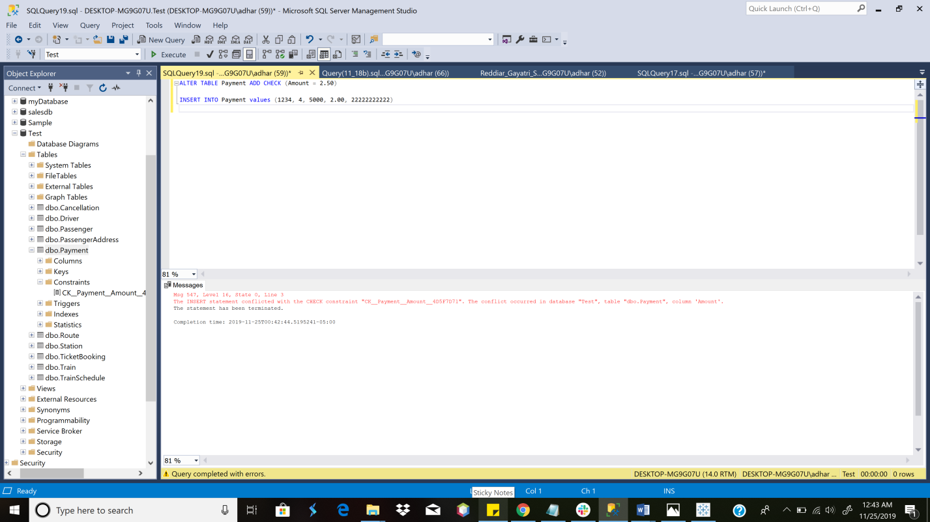
TABLE LEVEL CHECK CONSTRAINTS (ON PAYMENT TABLE)

Slide 27
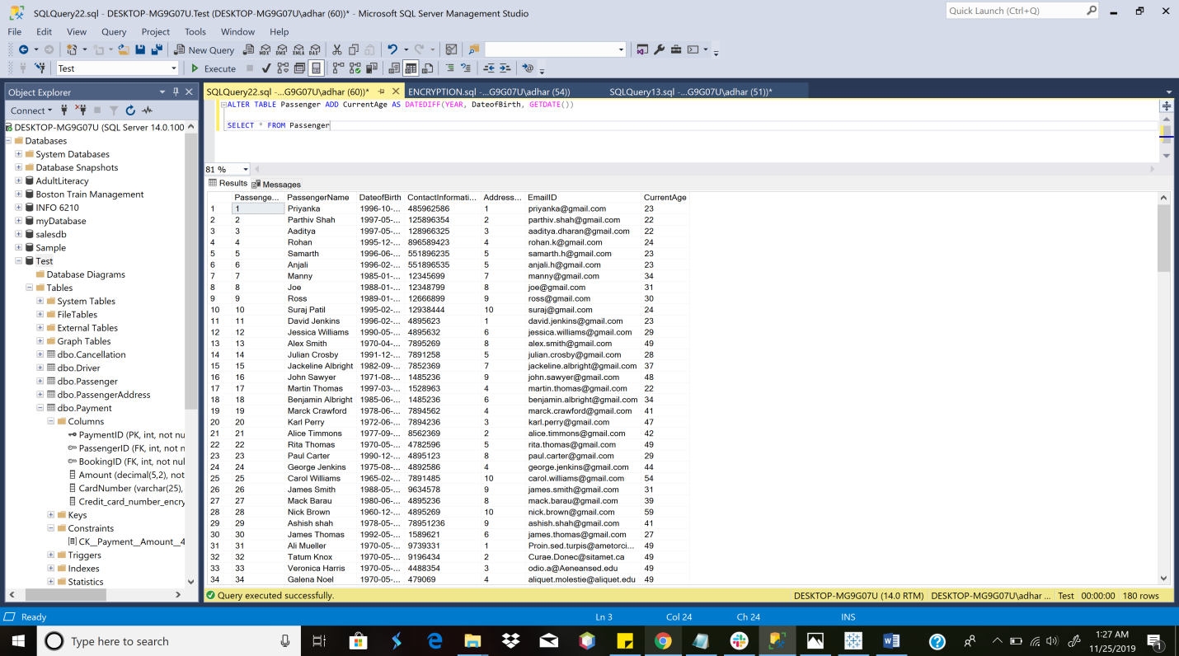
COMPUTED COLUMNS BASED ON FUNCTION

Slide 28
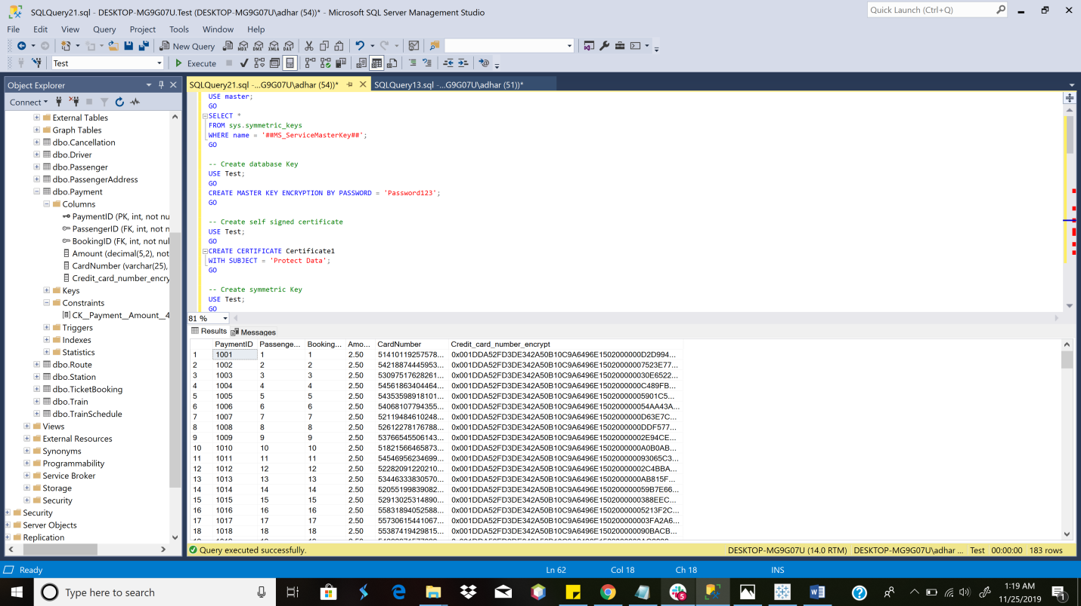
COLUMN DATA ENCRYPTION

Slide 29
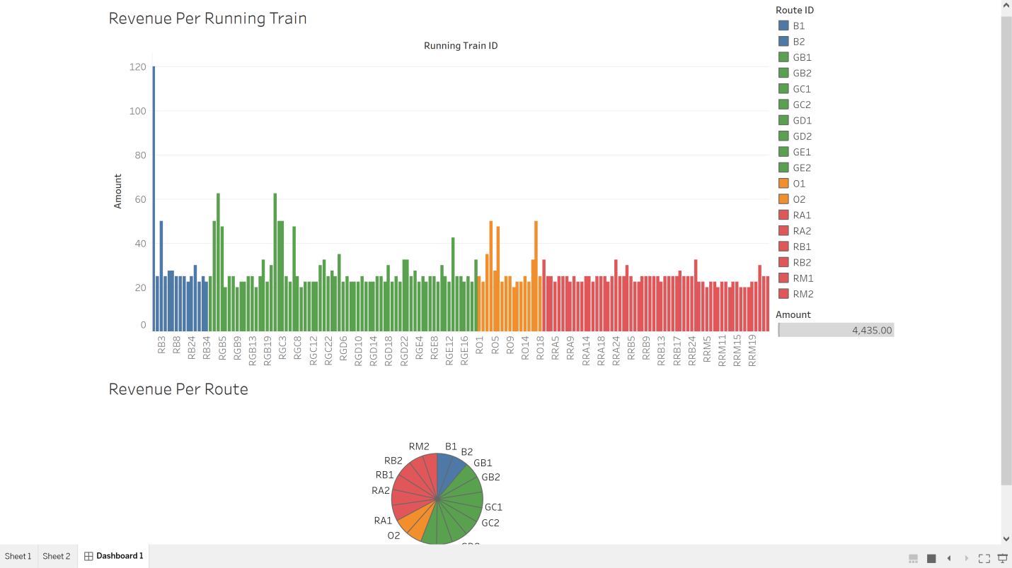
DASHBOARD
-Bar Graph for Revenue per Train Route which is further divided into Individual Running Trains.
- Pie Chart for Revenue per Train Route

Slide 30
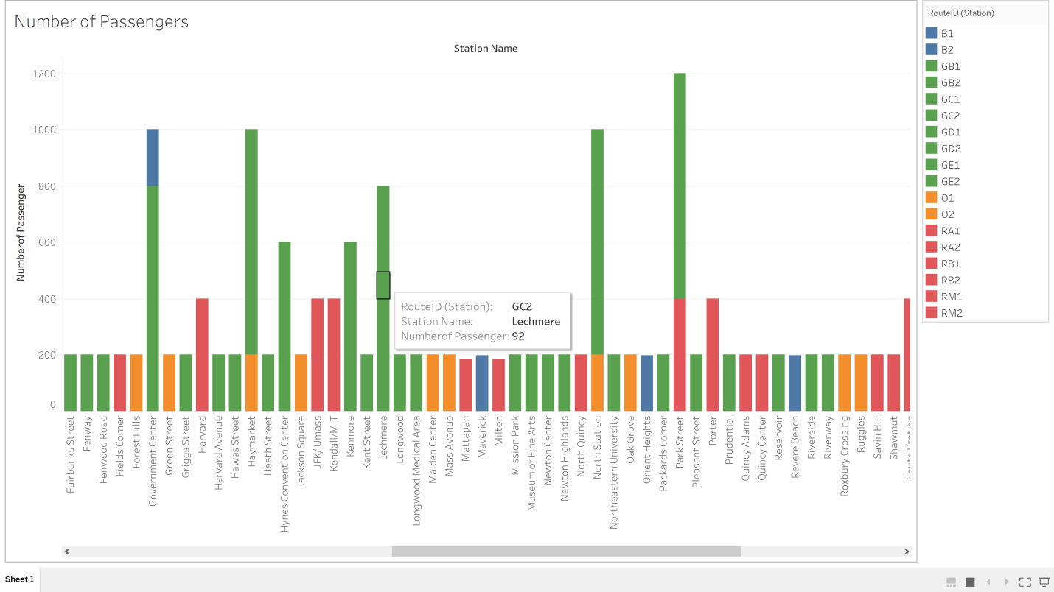
DASHBOARD
-Bar Graph for Number of Passengers boarding at a particular Station (Over Multiple Lines)

Slide 31
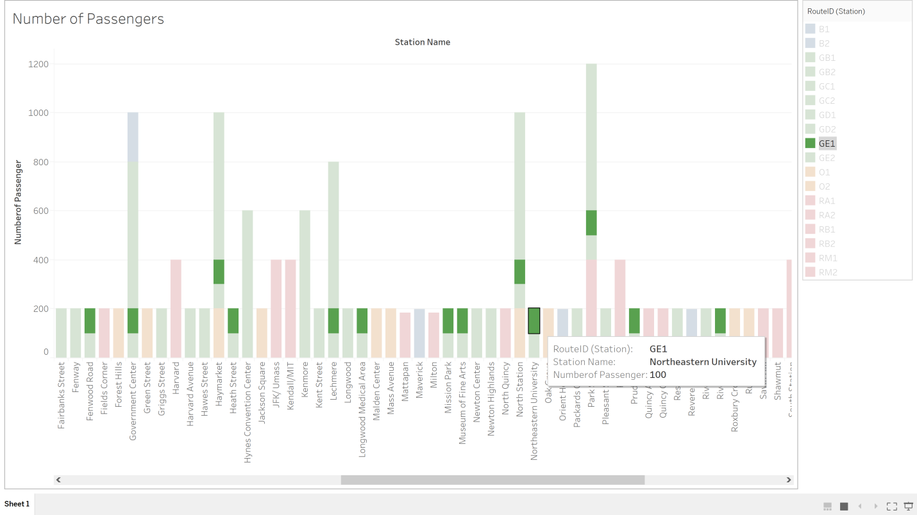
DASHBOARD
-Bar Graph for Number of Passengers at a particular station(Northeastern) on a particular route(GE1)

Slide 32
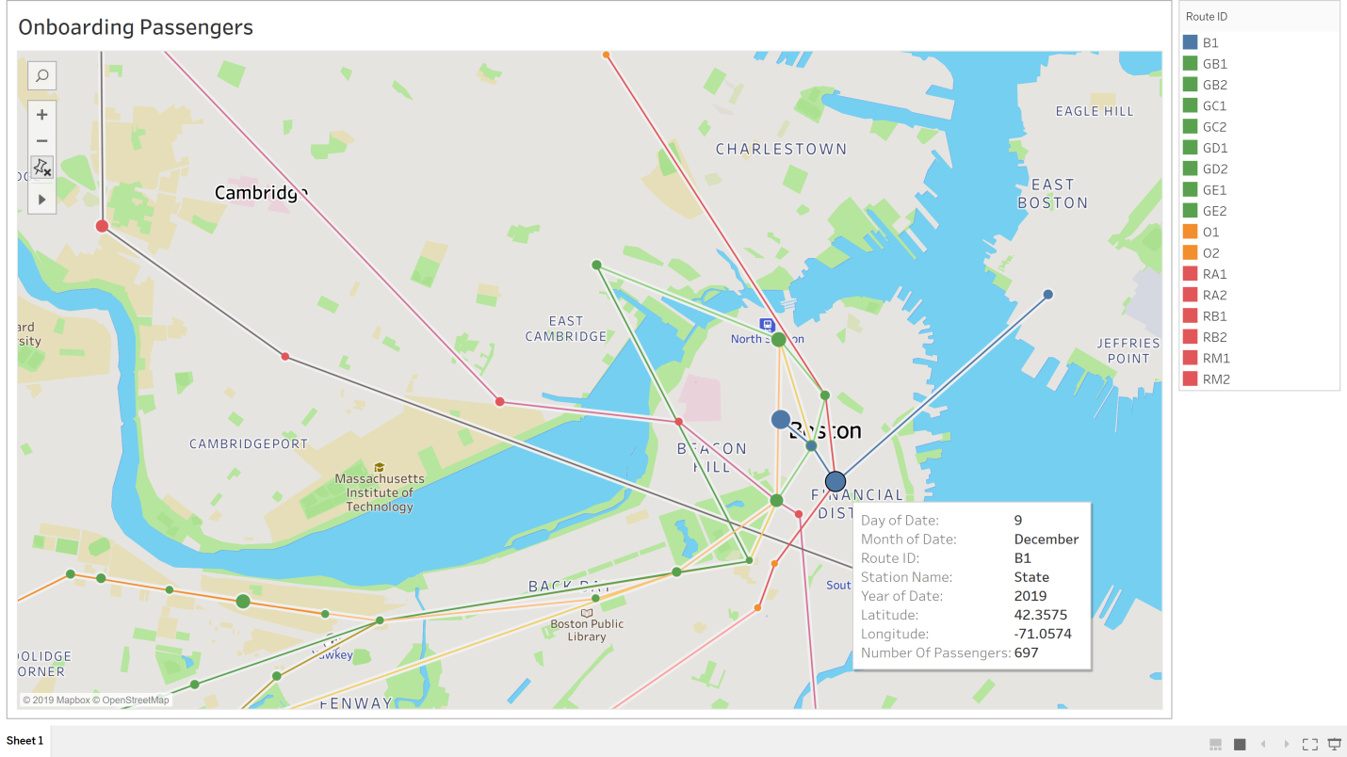
DASHBOARD
-Data points on a map indicating details about: Onboarding passenger on a particular Route, Station, Date
-Size of the datapoint represents the number of onboarding passengers at a particular Station

Slide 33
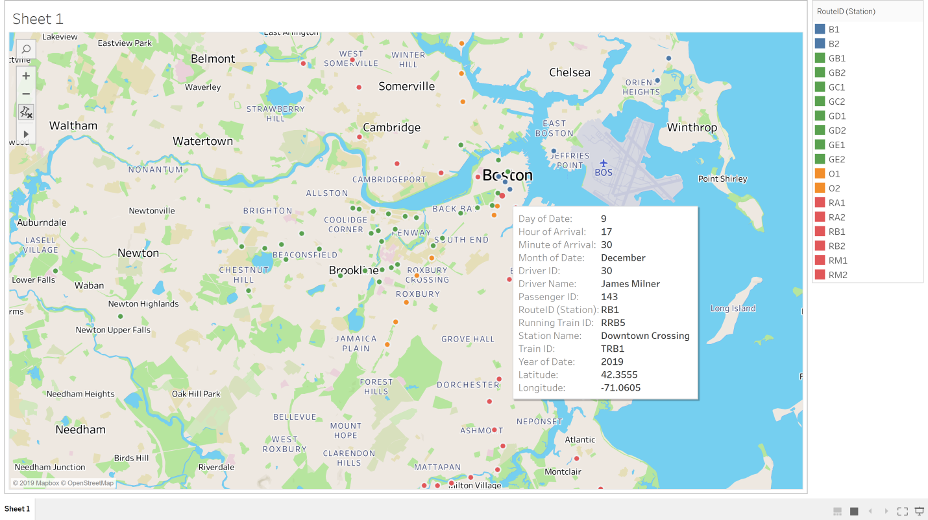
DASHBOARD
-Data Points on a map indicating details about :Onboarding Passenger on a particulartrain, route, station, date and time

Slide 34
CONTRIBUTION
Additya Dharangaonkar : ERD, DDL ,Stored Procedures
Samarth Hadawale : DML, Dashboard(Tableau), Documentation
Rohan Kapadnis : Triggers, Computed Columns
Priyanka Pal : Column Data Encryption, DML
Parthiv Shah : Check constraints, VIEWS, DDL

Slide 35
THANK YOU

